Slide 1


Slide 2


E-VEHICLE CHARGING USING COIN INSERTION

Slide 3
PRESENTED BY:
SIVAPRIYA S (927621BEC200)
GUIDED BY:
MR.K.SUDHAKAR
AP/ECE

Slide 4
CONTENTS:
INTRODUCTION
PROBLEM STATEMENT
OBJECTIVES
EXISTING SYSTEM
PROPOSED SYSTEM
BLOCK DIAGRAM
MODULES IDENTIFIED

Slide 5
INTRODUCTION:
This is the smart coin based E-Vehicle charging system that charges your vehicle for particular amount of time on inserting a coin.
The system is to be used by shop owners, public places like railway stations to provide vehicle charging facility. So the system consists of a coin recognition module that recognizes valid coins and then signals the microcontroller for further action.

Slide 6
PROBLEM STATEMENT:
In today’s world, e-vehicles are considered as the important part of life. People tend to use its huge features, which consumes charging. Peoples who use to make every long journey may require charging anywhere.
So in order to overcome all these problems E-Vehicle Charging Based on Coin Insertion is designed. To provide reliable charging services with less cost.

Slide 7
OBJECTIVES:
E-Vehicles are phenomenal in recent years for communication as well as in day-to-day life. Hence, charging the e-vehicle has become the greater task.
In this paper ,we are trying to design a E-vehicle battery charger on coin insertion.
As uses of E-vehicles are increasing day by day it need battery life all the time, so in order to use them public charging is needed which would be useful for E-vehicle users.

Slide 8
EXISTING SYSTEM:
First LCD will display to insert the type of coin then user will insert the coin. When a coin is detected by a vending machine.
After this LCD will display select port terminal .
The Microcontroller will check for new coin if new coin is detected then it will add delay count.
When count is equal to zero the charging stops .Same procedure will be repeated when user will again enter new coin.

Slide 9
PROPOSED SYSTEM:
The system uses a coin acceptor machine which will detect for a valid coin. The coin acceptor is connected to Arduino board and it then connected to the LCD display.
The relay will control the power supply to charger, after completion of time duration it will stop supplying power.
The LCD screen will show how much time left for the charging if the user wants to increase the duration of charging he needs to add another coin then the microcontroller adds the time in currently remaining time.

Slide 10
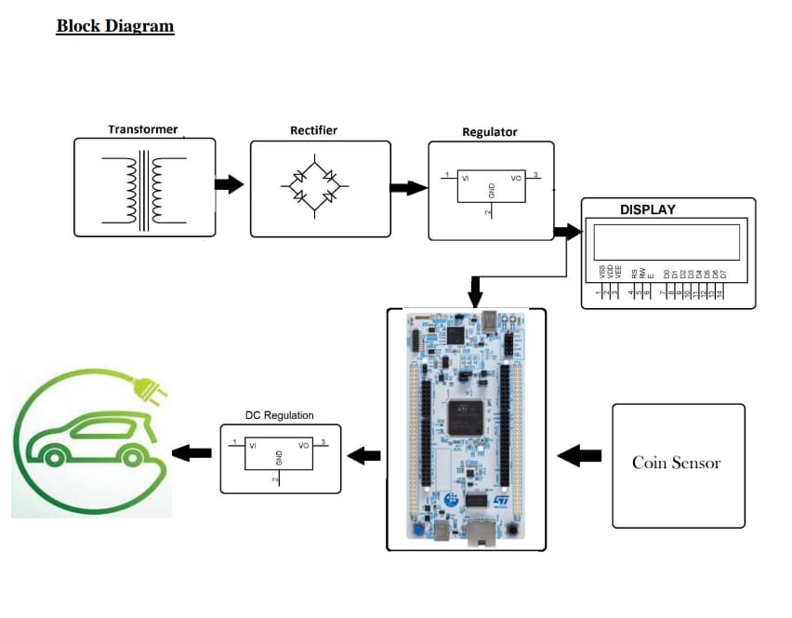
BLOCK DIAGRAM:

Slide 11
MODULES IDENTIFIED:
Input stage-To recognize and accept the valid coins
Controller-To control the voltage supplied
Power-To supply the power based on the requirements
Output stage-To display the output information on screen

Slide 12
CONCLUSION:
In this project, a coin insertion based e-vehicle charging system is developed which can be installed at public places.
Interfacing of various components like the coin insertion machine, LCD, 4*4 matrix keypad, servo motors with the Arduino microcontroller, and programming each of the components to function satisfactorily forms the heart of this project.

Slide 13
OBJECTIVE MET:
In this project we have tried to design a E-Vehicle battery charger on coin insertion, so by using this project we have achieved our objective of design of E-Vehicle battery charger on coin insertion.

Slide 14
STATUS OF THE PROJECT:
We have applied for National Conference on Innovative Research in Electronics and Communication Engineering at KARPAGAM INSTITUTE OF TECHNOLOGY, Coimbatore, TamilNadu.
Date:28/10/23(Online mode)

